Slide 2
Opportunities for Electrification in Public Power Utilities
Paul Zummo Director, Policy Research and Analysis American Public Power Association
May 8, 2019 Municipal Electric Association of Massachusetts

Slide 3
Presentation Outline
Declining sales and grid defection
Electric Vehicles
Other forms of electrification
Public power case studies
Resources

Slide 4
A thousand words (or more)

Slide 5
Causes of Sales Stagnation
Energy Efficiency: Overwhelmingly responsible for sales decline/stagnation until this point
Distributed Generation: Minimal impact outside of certain corridors, but its impact will become more prevalent
DG+Storage: Could threaten long-term viability of utilities

Slide 6
The Growth of Solar
Source: GTM Research and SEIA

Slide 7
Grid Defection – Will it Happen?
DERs/DG growth will continue
Sales are already declining
This puts pressure on utilities thanks to current rate design
Potential “death cycle” impacts with attempts to change rate design
BUT . . . Complete defection impractical for most

Slide 8
Technical Limitations

Slide 9
The Cleveland Effect

Slide 10
$$$$$$$$$$$$$$$$
5.5 kW solar panel: $10,000 - $12,000
7 kW Tesla Powerwall: $5,000-$8,000
May need 2x of the above to achieve current levels of reliability
May need to invest upwards of $30,000
Average monthly electric bill: $114
20-30 year payback

Slide 11
Electrification

Slide 12
Electrification: A Game Changer
“Efficient” or “beneficial” electrification
Rise of Electric Vehicles brings new load (and new challenges to grid)
Other forms of electrification: water heaters and electric heating
Opportunities for load growth through electrification, but also new load profiles

Slide 13
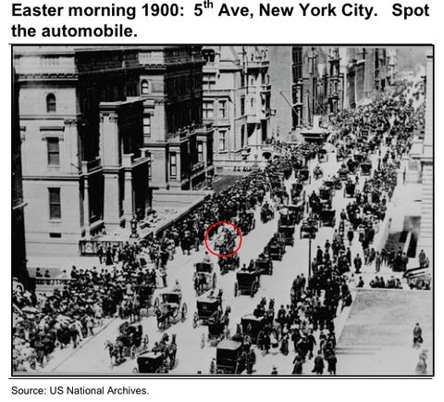
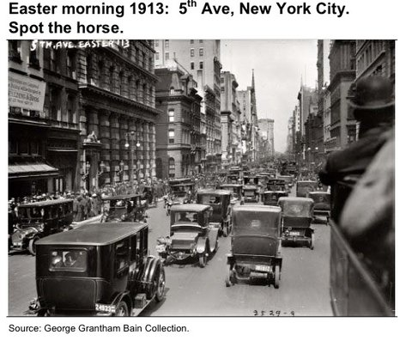
Don’t Underestimate How Fast Technological Change Can Happen
https://www.businessinsider.com/5th-ave-1900-vs-1913-2011-3

Slide 14
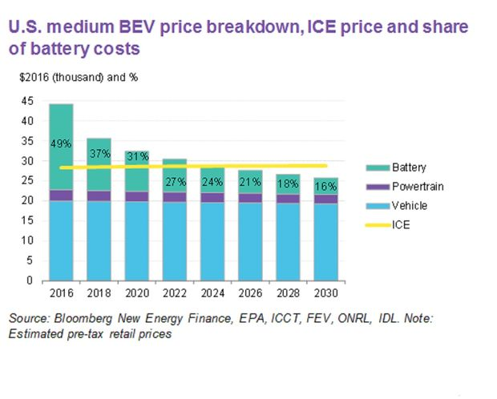
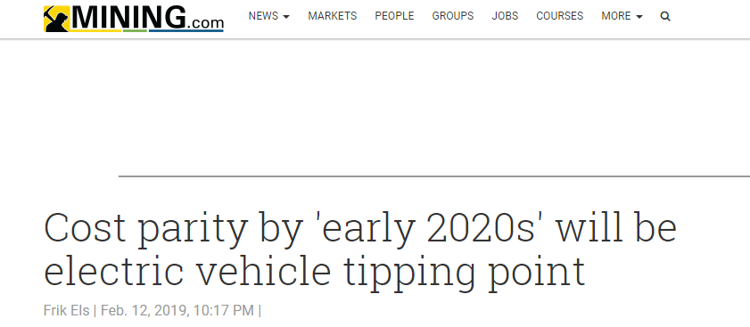
EVs are Getting More Competitive
Battery prices continue to decline
Various organizations project EVs to reach cost parity with internal combustion engine (ICE) vehicles in the near term

Slide 15
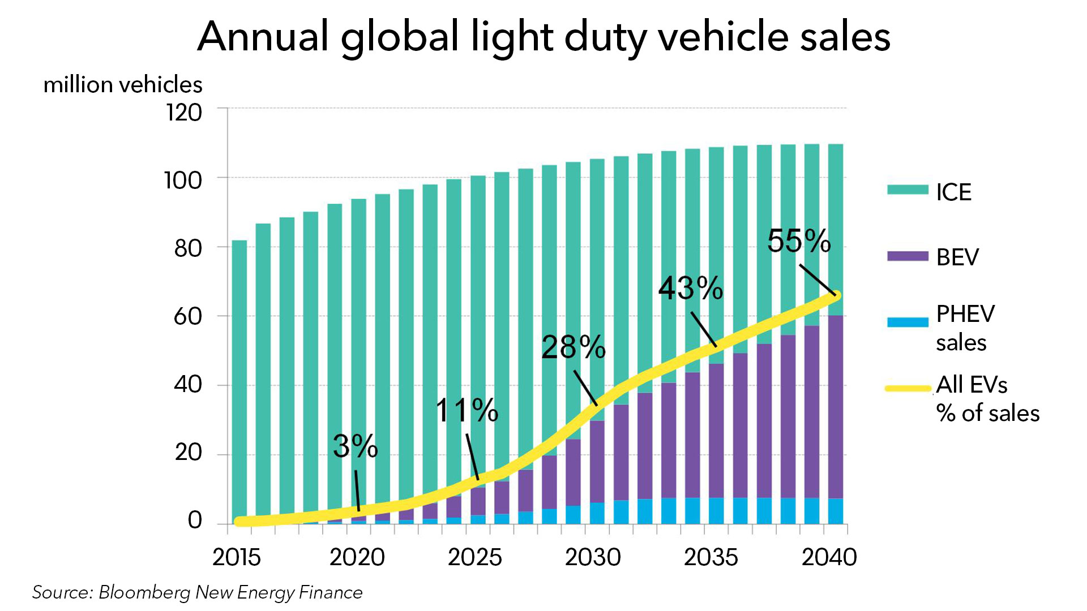
Global EV Sales are Increasing
Projected to have 125
million EVs globally by
2030
Major markets
include Europe and
China
Norway is leading by market share
6.4% of cars are powered by electricity
39% of new car sales are EVs
https://www.cnbc.com/2018/05/30/electric-vehicles-will-grow-from-3-million-to-125-million-by-2030-iea.html

Slide 16
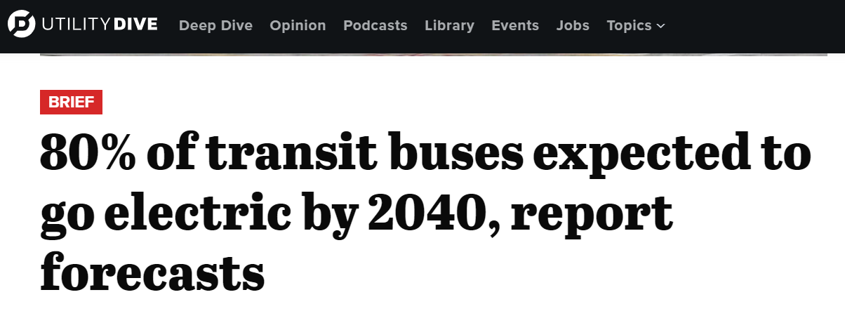
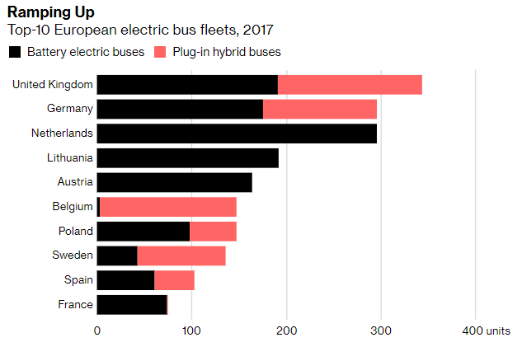
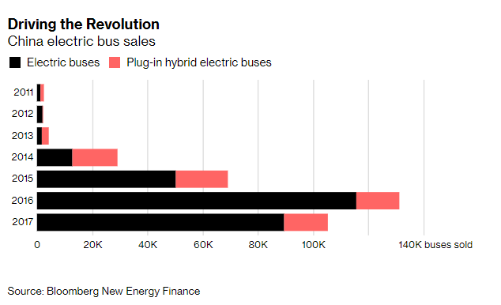
Transportation Electrification is Occurring for Light Duty , Medium Duty, and Heavy Duty Vehicles

Slide 17
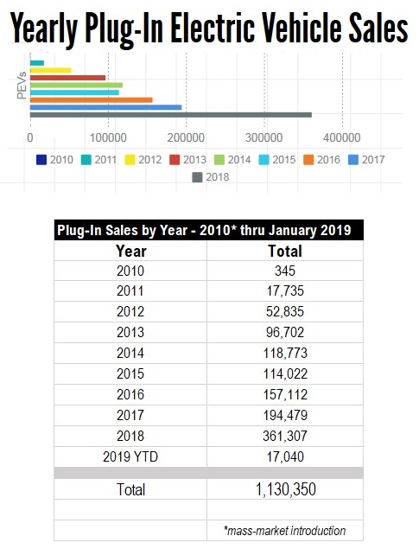
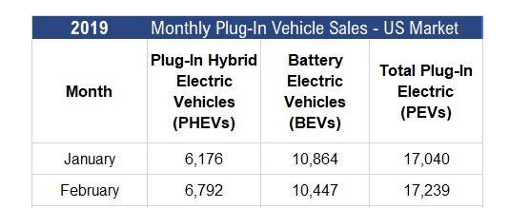
US EV Sales Continue to Increase
https://electricdrive.org/index.php?ht=d/sp/i/20952/pid/20952

Slide 18
Why Should You Care About EVs?
The good…
Load and revenue growth opportunity
Lower vehicle operating and maintenance costs
No tailpipe emissions
The bad…
If left unmanaged, customers can add to your peak demand, or stress distribution and transmission infrastructure (TOU rates)

Slide 19
Charging Station Availability
Limited charging infrastructure nationwide
Customers may experience range anxiety
Utilities and 3rd parties are looking to expand infrastructure
Tools are available to identify charging infrastructure in your community and region
Remember: 90% of charging done at home

Slide 20
What Your Utility Can Do
Deploy charging infrastructure
Educate employees, customers and auto-dealers
Electrify fleets (APPA paper forthcoming)
Evaluate rate design and payment options
Pilot vehicle-grid integration technologies
Provide incentives
Understand EV adoption and grid impacts

Slide 21
It’s not just cars
Electric water heating
EWH potentially 3x more efficient
EWH also a potential storage source enabling load control
Electric building heating
Also 2-4x more efficient than current forms of heating (unfortunately less efficient in northern/colder climates
All told: EPRI projects 1.2 – 2.7% annual sales growth due to electrification

Slide 22
Public Power Case Studies

Slide 23
Austin Energy – EV 360
A residential subscription pricing model that allows unlimited electric vehicle charging at home and around Austin, as part of the public charging network
Separate sub-meter
$150 Enrollment fee with no discounts
Access to public chargers
$30 or $50 per month
Weekday 2-7 P
Non-summer 14 cents per kWh
Summer 40 cents per kWh

Slide 24
City of Palo Alto
“Electrify Your Drive” page on its website – features suite of resources for customers
Provides latest news, including updates on charging infrastructure
Map located on page indicating where there are charging stations
“Let’s Get Started” page with FAQs and answers on incentives, rates, and charging structure installation
Has developed EV cost calculator allowing customers to review personal estimates, compare options, and make informed decisions

Slide 25
Lodi Electric Utility – EV TOU
Rate design for EV customers containing three components: monthly fixed charge, TOU energy rate, and the utility’s cost adjustment
EV charging period is from 8 PM to 6 AM, Monday-Friday, and all day weekends and holidays; rate is set at the lowest tier one rate
Non-EV charging period is 6 AM to 8 PM, M-F; rate set at highest residential rate (Tier 3)

Slide 26
Burlington Electric Deptartment - Rebates
Burlington offers customers a $1,200 rebate for all-electric vehicles and $600 for plug-in hybrids
Lower income customers may be eligible for an additional $600 rebate

Slide 27
SMUD – All Electric Smart Home
SMUD works with local builders to make homes available in many areas and price ranges
Home builders receive incentives for participating – up to $5,000 for single-family home and $1,750 for multifamily
Touted benefits for builders: improved market appeal to sustainably-minded homebuyers; increased placement flexibility of major home appliances; no increase in construction costs
Recommended technologies: solar PV plus storage, heat pump HVAC system, induction cooking, smart thermostat, heat pump dryer, EV charging, hat pump water heater
Projected electric consumption: 7,670 kWh/year (compared to 4,530 kWh), but reduced total energy bill, (approximately $130 annual savings)

Slide 28
Resources

Slide 29
APPA PPF Resources
Electric Vehicles
Creating an Electric Vehicle Blueprint for Your Community
Understanding the U.S. Plug-In Electric Vehicle Market
Public Power EV Activities Tracker
Electric Vehicle Interest Group
Energy Storage
Behind-the-Meter Energy Storage
Understanding Energy Storage
Solar
Value of Solar Primer
Community Solar A-Z
Rate Design
Coming Soon! Future of Rate Design
Rate Design Options for Distributed Energy Resources
Rate Design Interest Group
Other
Value of the Grid
Creating a Smart City Roadmap
Distributed Energy Resources and Public Power
https://www.publicpower.org/public-power-forward

Slide 30
Creating an Electric Vehicle Blueprint for Your Community
Published in September 2018 and available at our product store
External reviewers included public power utility members, Electric Drive Transportation Association, ChargePoint, General Motors, U.S. Department of Energy, & National Association of State Energy Officials

Slide 31
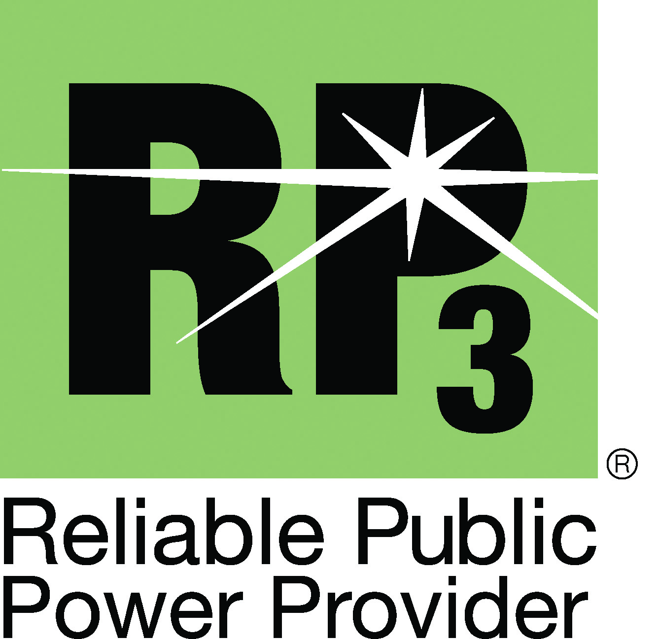
DEED Benefits Overview
National research program
Funding for innovative projects
Pipeline for student assistance & recruitment
Knowledge/tech transfer – reports, webinars, discounted resources
Gain recognition via DEED awards & points towards designation

Slide 32
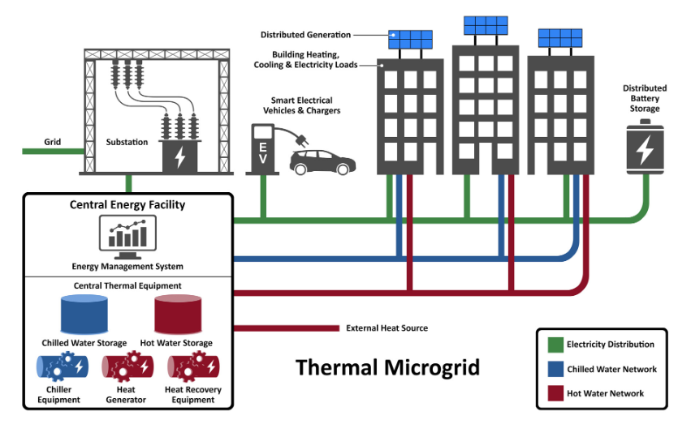
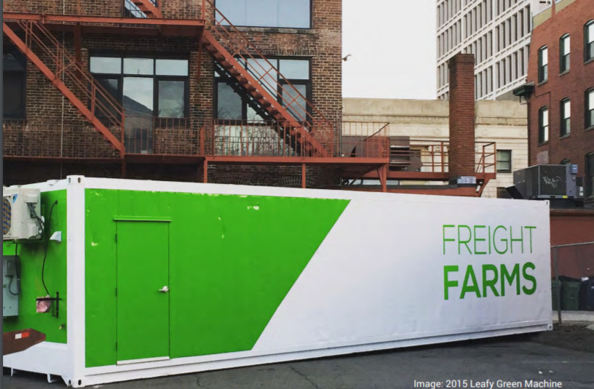
DEED Projects
Efficient Electrification of Indoor Food Production
Thermal Microgrid Feasibility Assessment Tools & Case Study
City of Palo Alto Utilities, G-397
Missouri River Energy Services, CG-2190

Slide 33
DEED Projects
Current Grants/Scholarships
CG-2130 Analytics Using StorageVET
CG-2152 Public Power EV Planning Toolkit and Guidebook
CG-2124 Burbank Water and Power Charge at Work Pilot
CG-2197 EV data collection in a midsized, Midwestern City
CS-2186 Electric Vehicle Load Prediction and Charging Scheduling for Grid Services and Cost Reduction

Slide 34
Funding Opportunities
State may have grant or loan programs to promote adoption or enhance the technology
Example:
Utah Clean Fuels and Vehicle Technology Grant and Loan Program

Slide 35
Tax and Other Incentives
State tax incentives are in addition to the federal tax incentive
Historically strong impact on EV sales
Other incentives include no emissions tests, HOV lane access, reduced registration fees

Slide 36
Other Industry Resources
Electric Power Research Institute – Efficient Electrification Initiative: https://www.epri.com/#/pages/sa/efficient-electrification?lang=en-US
National Renewable Energy Laboratory (NREL) – Numerous Publications on EV Grid Integration: https://www.nrel.gov/transportation/project-ev-grid-integration.html#pubs

Slide 37
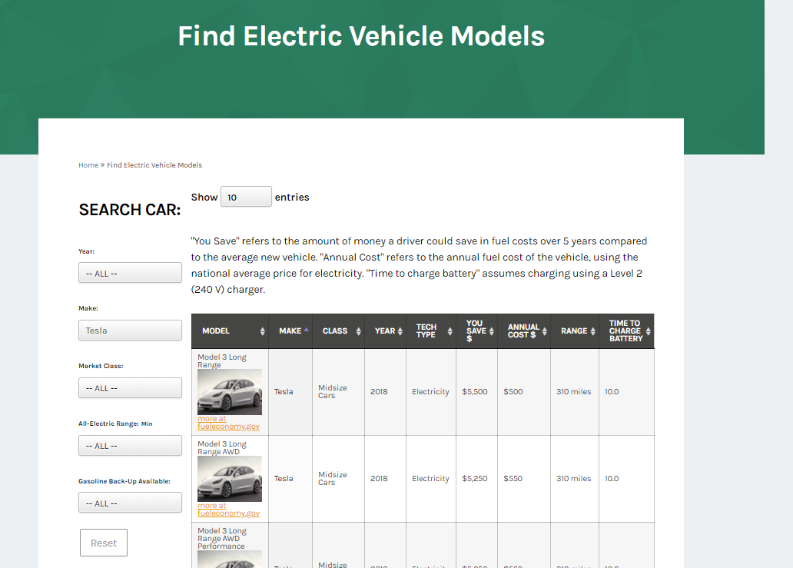
Department of Energy Tool
https://www.energy.gov/eere/electricvehicles/find-electric-vehicle-models

Slide 38
Thank You
Questions? Paul Zummo pzummo@publicpower.org
(202) 467-2969

