Slide 1
The Story of Public Power:
Communications Resources
Jackie Pratt, SELCO

Slide 2
New MEAM Communication Strategy
Political pressure to increase renewable and efficiency efforts.
Many outside of our footprint are not aware of the benefits of public power or the programs we offer. Utilities need to make a concerted effort to proactively share “Our Good Story” and increase awareness of Public Power in Massachusetts.
MEAM has identified four main points to highlight.

Slide 3
Local Control
Each utility is uniquely governed, community by community, to meet local desires.

Slide 4
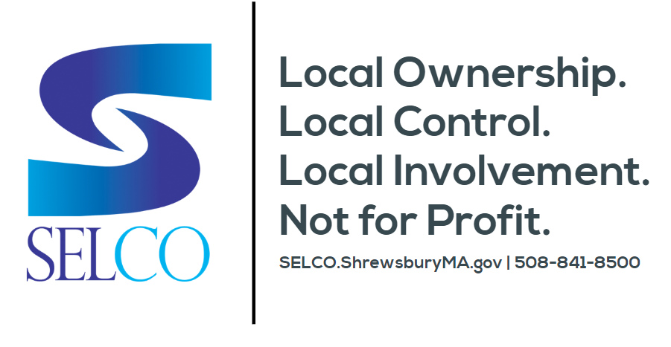

Slide 5
Reliability
Public Power utilities have faster restoration times and well-maintained infrastructure.

Slide 6
Accountability
Not-for-profit Public Power utilities are accountable to their customers and aim to provide the best service at a fair price.

Slide 7
Responsibility
MEAM member utilities balance environmental stewardship with fiscal responsibility to best serve their customers.

Slide 8
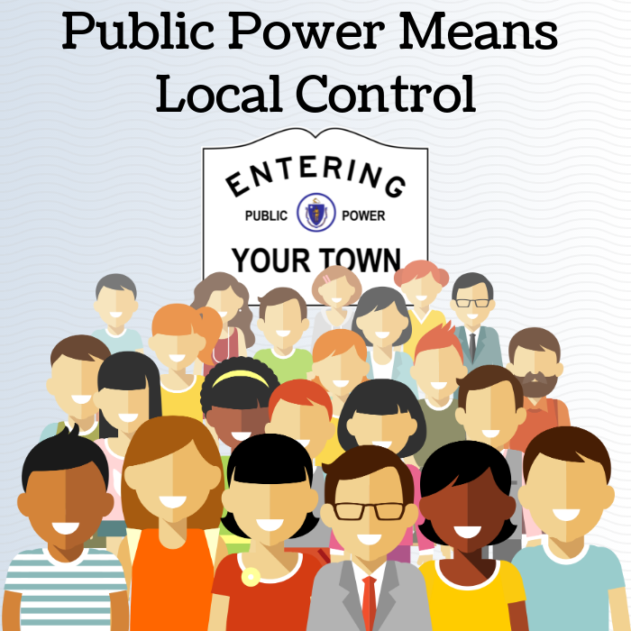
Public Power Proud Campaign (MEAM-CES.org)
Specific to MEAM Member Utilities
Password Access - Online Sign Up
Video Content
Good for website, social, and paid advertising (e.g. YouTube)
Can Brand with YOUR Utility Logo
Web & Social
Simple social posts. Can also be used on website.
Print
Newsletter, Bill Insert. Fact Sheets Coming SOON!

Slide 9
Public Power Messaging - APPA (PublicPower.org)
Community Powered Awareness Campaign:
www.WeAreCommunityPowered.com
The community owns the utility and the utility is accountable only to the community.
Leverages the power of your relationships and connections in your community.
Designed for implementation primarily through social media and local community events.
Communication Templates
Social Media Tips & Tutorials
Communications Plan Template
Various Resources for Social & Web Content by Topic and Month

Slide 10
Public Power Messaging - APPA (PublicPower.org)
Public Power Forward
Fact Sheets (e.g. Community Solar, EVs, etc.)
Smart Energy Provider Program (Due May 15th)
Shows proficiency in energy efficiency, distributed generation, renewable energy, and environmental initiatives.
National recognition of utility efforts to incorporate energy efficiencies and sustainability while providing affordable electric service.
$250 for utilities with less than 5,000 customers / $500 for 5,000 - 30,000 customers

Slide 11
Efficiency Messaging - Energy Star (EnergyStar.gov)
Partner Resources for Utilities
Products Programs
New Home Programs
Commercial & Industrial Programs
Home Performance with Energy Star
Fact Sheets & Reports
Marketing Materials
Social Media Posts
Awareness Programs & Campaigns

Slide 12
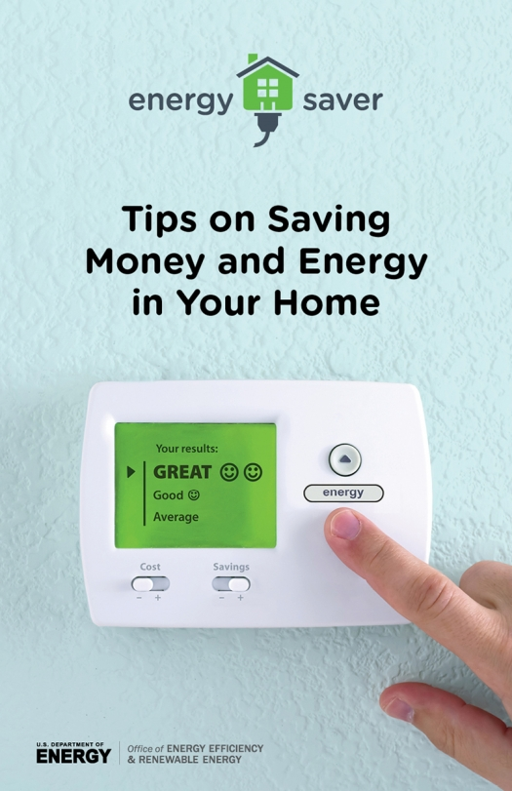
Energy Efficiency Messaging - DOE (Energy.gov)
“Save Energy, Save Money” Resources
Energy Saver Guide
Blog Posts (e.g. “16 Ways to Save Money in the Laundry Room”
Videos (e.g. Thermostat Explainer)
DIY Project Step-By-Step Guides

Slide 13
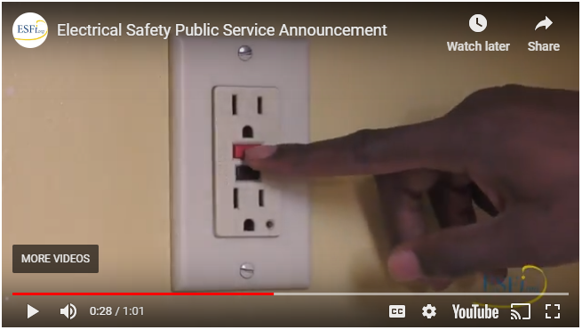
Safety Messaging - ESFI (ESFI.org)
Electrical Safety PSA Videos
Social Media Posts
Infographics
Fact Sheets

Slide 14
QUESTIONS?

